Slide 1

IT CAPS Content Development
Grade 12
Internet Technologies: Internet and WWW
Trends and emerging technologies &
Improving Searching

Slide 2
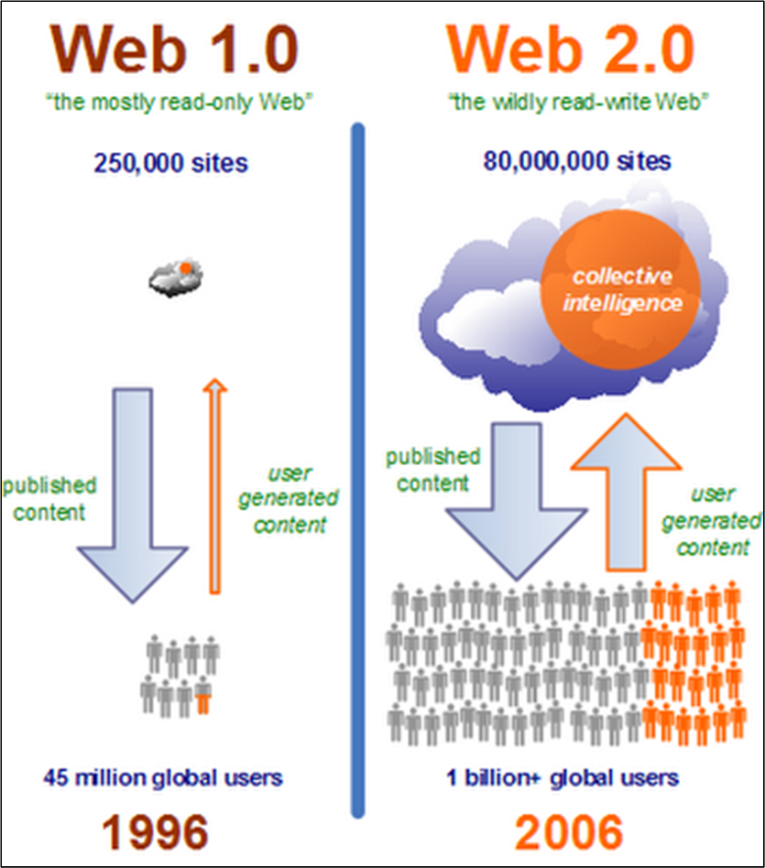
Web 1.0
Web 1.0
Provided information, similar to a library.
Static pages using HTML.
Included hyperlinks.
Users were consumers of content and not creators of content on the web.

Slide 3
Web 2.0
Web 2.0
Users become creators of content on the web.
Pages are dynamic.
When you buy one item suggestions are made that you will also / might also like another.
Examples include:
Amazon.com. Once you have bought a book / rated the book you read, the website will provide you with a list of books that you might enjoy according to your previous purchase / review.
Facebook, Twitter, Pinterest

Slide 4
Web 3.0
Web 3.0 /Semantic Web – the Internet of the future
Web 3.0 is an intelligent web that connects data, concepts, applications and people
It is a future development as an Internet providing you with a service, dependent on mobile devices built on the Internet of “things”.
The internet provides us with an overload of information.
Searching for an item provides too many options that you were NOT looking for or too few of what you needed.
The development of Web 3.0 is driven by user demands and technology development.
Devices interact with the web without user input.

Slide 5
Web 3.0
Web 3.0 /Semantic Web will be:
Secure
Efficient
Reliable
Scalable
Interoperable
Consistent
Pervasive
Coherent

Slide 6
Web 3.0
Web 3.0 /Semantic Web
Like having a Personal Assistant.
Focus on the needs of the user of the internet.
Searches will be tailored to a specific user.
Filtering information according to a user’s information collected from previous searches.
Two users will not get the same result for the same search due to information collected.
A mom searching for a biscuit recipe will get a different result from a chef doing a search with the same keywords, due to their different online identities.

Slide 7
Semantic Web
Web 3.0 / Semantic Web:
There are over 30 trillion websites on the web.
Old Boolean searches would find strings in the search in the:
URL
Title of the website
Content of websites
10 best pages that will possibly meet your query will be on the first page of the search result.
Statistically the best website will be the first.
The user is responsible to sift through the websites to find the one that suit their needs.

Slide 8
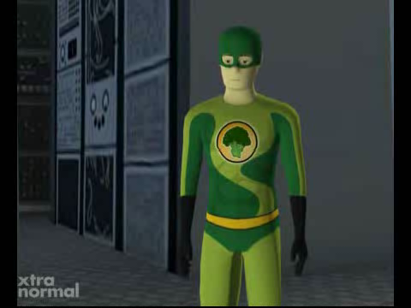
Web 3.0 - Video

Slide 9
Semantic Search
Semantic Search
Semantic originated from a Greek word for “meaning”.
It is the change from a web of websites to a web of people.
When you search for Pizza in the morning at 7am the search engine assumes you are looking for information about Pizza like where it originated from or recipes.
When you search for Pizza at 7pm it assumes you are looking for contact details of a place to buy Pizza from.
If you were looking for Pizza to buy for breakfast at 7am, your search will be cached.
Next time you search for Pizza in the morning the search engine will provide you with contact details to buy a Pizza since it knows you like Pizza for breakfast.

Slide 10
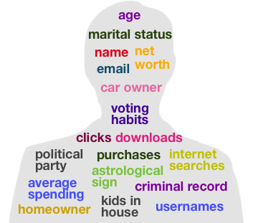
Digital Identity
Semantic Search
Through Google+ a digital identity is created for you. This will be formulated by:
Friends you have (Your social network)
Comments you make
Websites you visit
YouTube videos etc. that
you “Like”
Each link individually has little meaning but putting all the information together formulates your digital identity.

Slide 11
Semantic Search
Semantic Search
This information is used to refine your search according to your digital identity.
Two people that do the same search with different digital identities will not get the same search results.
A Semantic Search takes meaning from the links on your profile.
Semantic Search is like having a personal assistant that knows what your likes, dislikes and your interests are.

Slide 12
Semantic Search
Semantic Search and Company Websites:
Old searches allowed companies to use SEO to make sure their website will appear at the top of certain searches.
Now the search will look at who visited the page, what their authority is, comments on the website and base the search result on the trust authority / reputation of the website.
Results are now based on the trustworthiness of the website and not on how cleverly the website was developed using SEOs

Slide 13
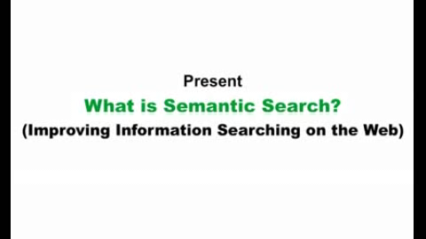
Semantic Search - Video

Slide 14
Mediated Search
Mediated Search
This search refers to someone doing a search on behalf of the user i.e. the person conducting the search.
Similar to asking a librarian to find you information on a topic and they conduct it on your behalf.
Also known as Directory Search Engine.
Searches are conducted by category.
Keywords are used to find websites according to a main category and then refined to specific topics under that category.
Examples: Yahoo! and Lycos

